Slide 1
3. Process and Thread
Course Exercise in Operating System

Slide 2
Contents
Program and Process
Thread and Process
Nachos Thread and Scheduler
Nachos Kernel Structure

Slide 3
Program and Process
After a program is compiled and linked, its binary executable is stored in a file.
  What does this file look like?
  What is its format?
It must contain the following sections:
  text : the binary code of the program to be executed
  initialized data: global variables with initial data
  the size of the uninitialized data :all un-initialized global variables are assumed to have value 0 and therefore, there is no need to store them in the binary executable.
Common Format of Executables
  COFF: common format for executable in UNIX
  NOFF: slightly different, used in Nachos

Slide 4
Program and Process
Let us have a look at NOFF
  #define NOFFMAGIC 0xbadfad /* magic number denoting Nachos*/
  / * object code file*/
  typedef struct segment {
    int virtualAddr; /* location of segment in virtual addr space */
    int inFileAddr; /* location of segment in this file */
    int size; /* size of segment */
  } Segment;
  typedef struct noffHeader {
    int noffMagic; /* should be NOFFMAGIC */
    Segment code; /* executable code segment */
    Segment initData; /* initialized data segment */
    Segment uninitData; /* uninitialized data segment --*/
    /* should be zero'ed before use */
} NoffHeader;

Slide 5
Program and Process
To run a program, the computer needs to load the executable into memory.
The memory required to run the program is called the address space.
Address space contains the following sections:
  Text: the binary code of the program loaded from the executable file
  initialized data: data area with initialized data copied the from the executable file
  bss : uninitialized data with zeros
  stack: stack area for procedure calls
  heap : area for dynamically allocated variables
Notes:
".bss" stands for "block starting symbol". After all, the only thing you can do in defining uninitialized data is to give a name to the beginning of a block of data.

Slide 6
Program and Process
A process is a program in execution.
Therefore, a process should be characterized by
  address space (text, data, stack and heap)
  program counter (PC): register for the address of next instruction
  stack pointer (SP): register for the address of the top of stack
  frame pointer (FP): register for the address of current stack frame
  Other registers (user and system registers)
  I/O resources (open files, open network sockets, etc)

Slide 7
Program and Process
Process Control Block (PCB): data structure to store all information to resume the process
  process state
  program counter (PC)
  current stack pointer (SP) and frame pointer (FP)
  other registers
  address space
  open I/O resources

Slide 8
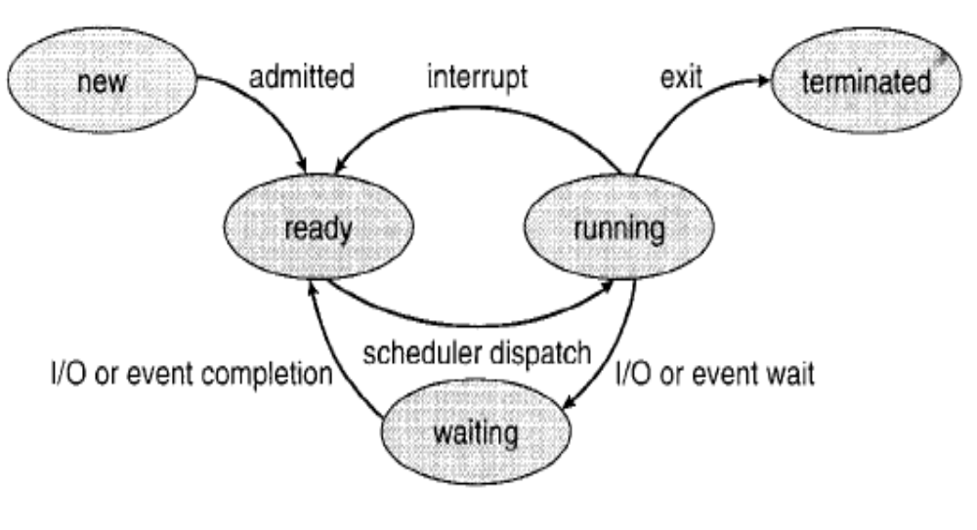
Program and Process
Process State
  Each process can be in one of the five states
    new
    ready
    running
    waiting
    terminated

Slide 9
Program and Process
State Transitions and their causes
  nothing to new: process creation
  new to ready: dispatch by job scheduler
  ready to run: dispatch by the CPU scheduler
  run to ready: time-out interrupt or others reasons
  run to blocked: requests for services of the operating system which take time to complete
  blocked to ready: completions of requested services

Slide 10
Program and Process
Where do the ready or wait processes stay?
  Address spaces stay in memory, but PCB information stays in queues.
  ready queue: store the PCB of the ready processes
  wait queues: store the PCB of the waiting processes

Slide 11
Program and Process
A context switch from process P1 to process P2 is required, when
  P1 is changed from running to blocked or ready and
  P2 is changed from ready to running
The context switch from P1 to P2 involves:
  save the context of P1 in its PCB and put it in an appropriate queue
  load the context of P2 from its PCB
  resume the execution of P2 from the address where it was stopped

Slide 12
Contents
Program and Process
Thread and Process
Nachos Thread and Scheduler
Nachos Kernel Structure

Slide 13
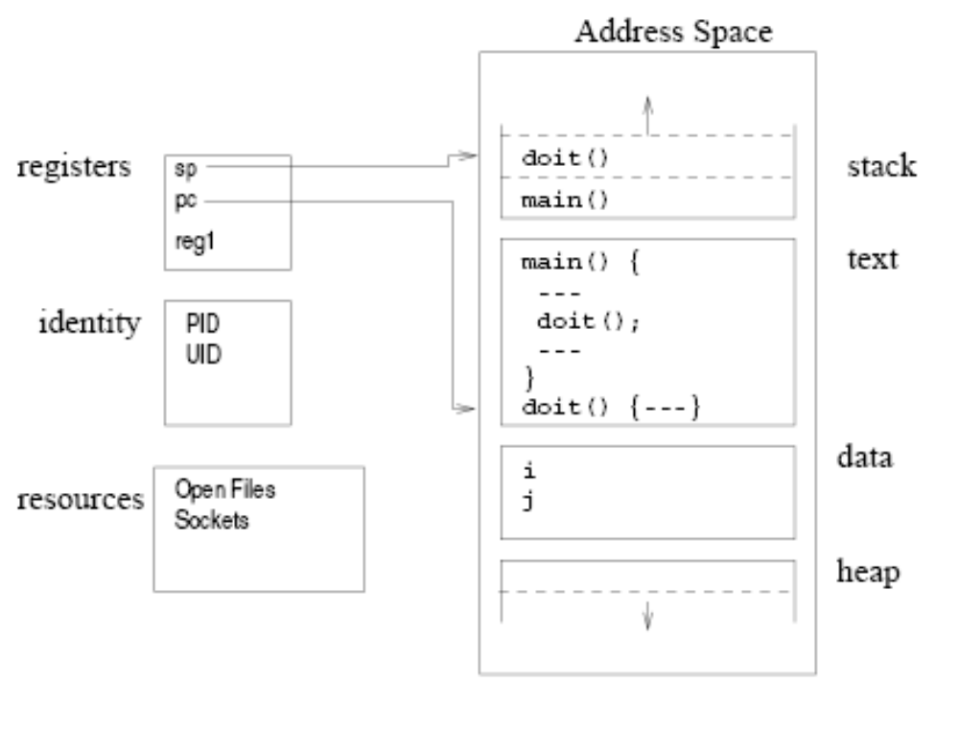
Thread and Process
Process is
  a unit of dispatching for execution (PC, SP, and stack)
  a unit of resource ownership (address space, open files, etc)
Components of a program in execution

Slide 14
Thread and Process
However, a process does not have to have only a single unit of dispatching.
A thread is an execution stream within a process. (dispatching unit)
A process can have multiple threads
  each has its own stack and control block (including thread state, id, etc)
  but all share the common resources of the process

Slide 15
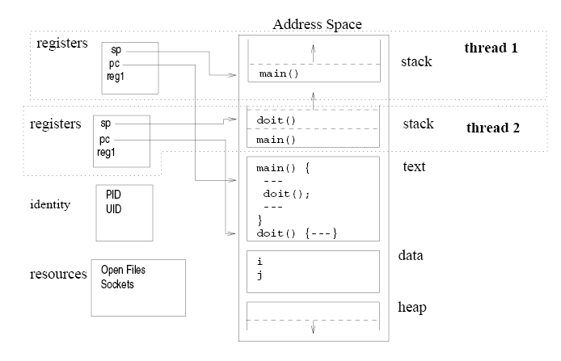
Thread and Process
Threads of a process

Slide 16
Thread and Process
Why threads?
It takes less time to
  create and terminate a thread than a process
  do context switch between threads than processes
Threads enable efficient communication because they share:
  the address space
  the resources owned by the process

Slide 17
Contents
Program and Process
Thread and Process
Nachos Thread and Scheduler
Nachos Kernel Structure

Slide 18
Nachos Thread and Scheduler
Development of Nachos
  At development and debugging phase, Nachos is running as a process in UNIX/Linux.
  On the raw machine, Nachos is running as the kernel of a real operating system. Nachos threads share the address space of the kernel.

Slide 19
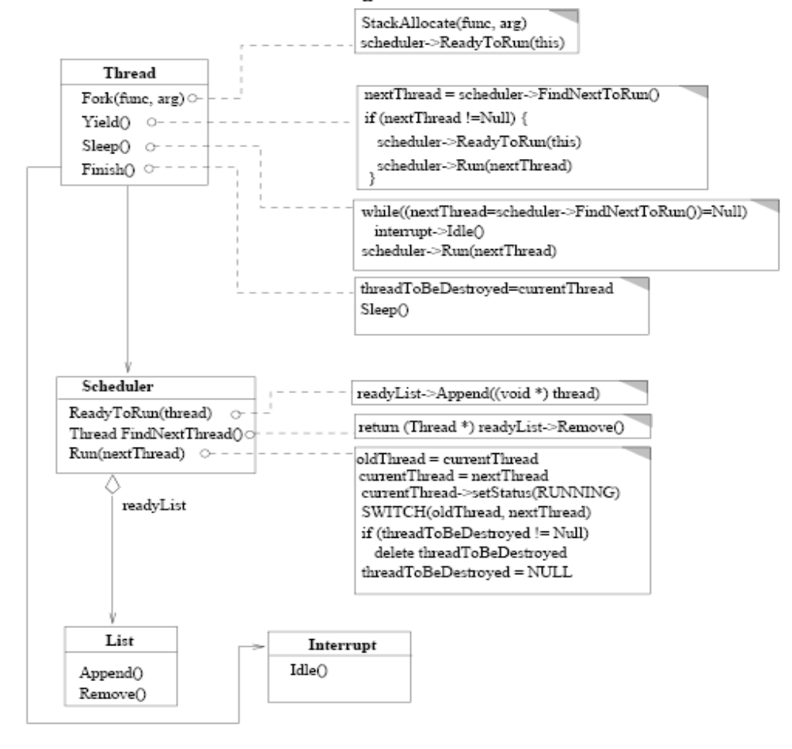
Nachos Thread and Scheduler
Nachos 线程实现框架图

Slide 20
Nachos Thread and Scheduler
Queues for Nachos Scheduler
files:
    ../threads/list.h
    ../threads/list.cc
classes
    class ListElement {
      public:
        ListElement(void *itemPtr, int sortKey);
        ListElement *next; // next element on list,
        // NULL if this is the last
        int key; // priority, for a sorted list
        void *item; // pointer to item on the list
    };

Slide 21
Nachos Thread and Scheduler
class List {
public:
  List(); // initialize the list
  ~List(); // de-allocate the list
  void Prepend(void *item); // Put item at the beginning of the list
  void Append(void *item); // Put item at the end of the list
  void *Remove(); // Take item off the front of the list
  void Mapcar(VoidFunctionPtr func); // Apply "func" to every element
  // on the list
  bool IsEmpty(); // is the list empty?
  // Routines to put/get items on/off list in order (sorted by key)
  void SortedInsert(void *item, int sortKey); // Put item into list
  void *SortedRemove(int *keyPtr); // Remove first item from list
private:
  ListElement *first; // Head of the list, NULL if list is empty
  ListElement *last; // Last element of list
};

Slide 22
Nachos Thread and Scheduler
Nachos Scheduler: A simple FIFO CPU scheduler
files
  ../threads/scheduler.h
  ../threads/scheduler.cc
When Nachos is started, an object of class Scheduler is created and referenced by a global variable scheduler
Contains a queue and various scheduling functions

Slide 23
Nachos Thread and Scheduler
  class Scheduler {
  public:
    Scheduler(); // Initialize list of ready threads
    ~Scheduler(); // De-allocate ready list
    void ReadyToRun(Thread* thread); // Thread can be dispatched.
    Thread* FindNextToRun(); // Dequeue first thread on the ready
    // list, if any, and return thread.
    void Run(Thread* nextThread); // Cause nextThread to start running
    void Print(); // Print contents of ready list
  private:
    List *readyList; // queue of threads that are ready to run,
    // but not running
  };

Slide 24
Nachos Thread and Scheduler
The ready queue to hold all the threads in the READY state
List *readyList;
Put this thread at the end of ready queue:
  void
  Scheduler::ReadyToRun (Thread *thread)
  {
    DEBUG('t', "Putting thread %s on ready list.\n", thread->getName());
    thread->setStatus(READY);
    readyList->Append((void *)thread);
  }
Select the thread to be dispatched:
  Thread *
  Scheduler::FindNextToRun ()
  {
  return (Thread *)readyList->Remove();
  }

Slide 25
Nachos Thread and Scheduler
Dispatch Function: calls SWITCH(..) to do the context switch
  void
  Scheduler::Run (Thread *nextThread)
  {
  Thread *oldThread = currentThread;
  #ifdef USER_PROGRAM // ignore until running user programs
  if (currentThread->space != NULL) { // if this thread is a user program,
  currentThread->SaveUserState(); // save the user's CPU registers
  currentThread->space->SaveState();
  }
  #endif
  oldThread->CheckOverflow(); // check if the old thread had an
  // undetected stack overflow
  currentThread = nextThread; // switch to the next thread
  currentThread->setStatus(RUNNING); // nextThread is now running
  DEBUG('t', "Switching from thread \"%s\" to thread \"%s\"\n",
  oldThread->getName(), nextThread->getName());

Slide 26
Nachos Thread and Scheduler
  SWITCH(oldThread, nextThread);
    DEBUG('t', "Now in thread \"%s\"\n", currentThread->getName());
    if (threadToBeDestroyed != NULL) {
      delete threadToBeDestroyed;
      threadToBeDestroyed = NULL;
    }
  #ifdef USER_PROGRAM
    if (currentThread->space != NULL) { // if there is an address space
      currentThread->RestoreUserState(); // to restore, do it.
      currentThread->space->RestoreState();
    }
  #endif
  }
Notes:
第一堂课到此结束

Slide 27
SWITCH(1)
84 # a0 -- pointer to old Thread
85 # a1 -- pointer to new Thread
86 .globl SWITCH
87 .ent SWITCH,0
88 SWITCH:
89 sw sp, SP(a0) # save new stack pointer
90 sw s0, S0(a0) # save all the callee-save registers
91 sw s1, S1(a0)
92 sw s2, S2(a0)
93 sw s3, S3(a0)
94 sw s4, S4(a0)
95 sw s5, S5(a0)
96 sw s6, S6(a0)
97 sw s7, S7(a0)
98 sw fp, FP(a0) # save frame pointer
99 sw ra, PC(a0) # save return address
100

Slide 28
SWITCH(2)
101 lw sp, SP(a1) # load the new stack pointer
102 lw s0, S0(a1) # load the callee-save registers
103 lw s1, S1(a1)
104 lw s2, S2(a1)
105 lw s3, S3(a1)
106 lw s4, S4(a1)
107 lw s5, S5(a1)
108 lw s6, S6(a1)
109 lw s7, S7(a1)
110 lw fp, FP(a1)
111 lw ra, PC(a1) # load the return address
112
113 j ra
114 .end SWITCH

Slide 29
Nachos Thread and Scheduler
Nachos Thread and its Control block
The thread control block of Nachos thread is implemented as the data member of Thread class.
  class Thread {
  private:
    int* stackTop; // the current stack pointer
    _int machineState[MachineStateSize]; // all registers except for stackTop
    ...
  private:
    // some of the private data for this class is listed above
    int* stack; // Bottom of the stack
        // NULL if this is the main thread
        // (If NULL, don't deallocate stack)
    ThreadStatus status; // ready, running or blocked
    char* name;
    ...
  };

Slide 30
Nachos Thread and Scheduler
  class Thread {
  private:
    int* stackTop; // the current stack pointer
    _int machineState[MachineStateSize]; // all registers except for stackTop
    public:
    ...
  private:
  ...
  #ifdef USER_PROGRAM
  int userRegisters[NumTotalRegs]; // user-level CPU register state
  public:
  void SaveUserState(); // save user-level register state
  void RestoreUserState(); // restore user-level register state
  AddrSpace *space; // User code this thread is running.
  #endif
  };
Nachos Process= Nachos Thread + Address Space + User Registers

Slide 31
Nachos Thread and Scheduler
The thread operations such as creation and blocking are implemented as methods of Thread class.
  class Thread {
    ...
    public:
      ...
      // basic thread operations
      void Fork(VoidFunctionPtr func, _int arg); // Make thread run (*func)(arg)
      void Yield(); // Relinquish the CPU if any
      // other thread is runnable
      void Sleep(); // Put the thread to sleep and
      // relinquish the processor
      void Finish(); // The thread is done executing
      void CheckOverflow(); // Check if thread has
      // overflowed its stack
      void setStatus(ThreadStatus st) { status = st; }
      char* getName() { return (name); }
      void Print() { printf("%s, ", name); }
  ...

Slide 32
Nachos Thread and Scheduler
Creation: Thread(char* debugName)
  implements the transition from “nothing" to “new"
  initializes all the private data members but machineState
    Thread::Thread(char* threadName)
    {
      name = threadName;
      stackTop = NULL;
      stack = NULL;
      status = JUST_CREATED;
    #ifdef USER_PROGRAM
    space = NULL;
    #endif
    }
The thread created is not ready to run yet.

Slide 33
Nachos Thread and Scheduler
Long-term scheduler dispatch:
void Fork(VoidFunctionPtr func, int arg)
  Implements the transition from " new" to " ready"
  Allocates the stack for the thread
  Set register states in machineState[] including the addresses of
    subroutines for initialization and clean-up
    subroutine to be executed for the life time of the thread and the argument (one) of the subroutine to be executed.

Slide 34
Nachos Thread and Scheduler
    void
    Thread::Fork(VoidFunctionPtr func, _int arg)
    {
    ...
      StackAllocate(func, arg);
      IntStatus oldLevel = interrupt->SetLevel(IntOff);
      scheduler->ReadyToRun(this); // ReadyToRun assumes that interrupts
      // are disabled!
      (void) interrupt->SetLevel(oldLevel);
    }

Slide 35
Nachos Thread and Scheduler
Private function which does the job for Fork(..): StackAllocate
  allocates a stack and initializes machineState[]
  void
  Thread::StackAllocate (VoidFunctionPtr func, _int arg)
  {
    stack = (int *) AllocBoundedArray(StackSize * sizeof(int));
    stackTop = stack + StackSize - 4; // -4 to be on the safe side!
    machineState[PCState] = (_int) ThreadRoot;
    machineState[StartupPCState] = (_int) InterruptEnable;
    machineState[InitialPCState] = (_int) func;
    machineState[InitialArgState] = arg;
    machineState[WhenDonePCState] = (_int) ThreadFinish;
  }

Slide 36
ThreadRoot
69 .globl ThreadRoot
70 .ent ThreadRoot,0
71 ThreadRoot:
72 or fp,z,z # Clearing the frame pointer here
73 # makes gdb backtraces of thread stacks
74 # end here (I hope!)
75
76 jal StartupPC # call startup procedure
77 move a0, InitialArg
78 jal InitialPC # call main procedure
79 jal WhenDonePC # when we are done, call clean up procedure
80
81 # NEVER REACHED
82 .end ThreadRoot
Notes:
StartupPC
InitalArg
InitialPC
WhenDonePC
是在switch.h中定义的宏，分别代表寄存器s3, s1, s0,和s2, 这些寄存器的值从machineState中装载进来
a0 寄存器，存放函数调用的第一个参数

Slide 37
Nachos Thread and Scheduler
Time-out: void Yield()
  implements the transition from " running" to " ready"
  voluntarily relinquishes CPU if there is another ready thread to run
  call scheduler->Run(nextThread) for context switch if needed
    void
    Thread::Yield ()
    {
      Thread *nextThread;
      IntStatus oldLevel = interrupt->SetLevel(IntOff);
      ASSERT(this == currentThread);
      DEBUG('t', "Yielding thread \"%s\"\n", getName());
      nextThread = scheduler->FindNextToRun();
      if (nextThread != NULL) {
        scheduler->ReadyToRun(this);
        scheduler->Run(nextThread);
      }
      (void) interrupt->SetLevel(oldLevel);
    }

Slide 38
Nachos Thread and Scheduler
Block (or wait): void Sleep()
  implements the transition from " running" to " blocked"
  void
  Thread::Sleep ()
  {
    Thread *nextThread;
    ASSERT(this == currentThread);
    ASSERT(interrupt->getLevel() == IntOff);
    DEBUG('t', "Sleeping thread \"%s\"\n", getName());
    status = BLOCKED;
    while ((nextThread = scheduler->FindNextToRun()) == NULL)
    interrupt->Idle(); // no one to run, wait for an interrupt
    scheduler->Run(nextThread); // returns when we've been signaled
  }
  Before calling this function, the thread usually puts itself into the queue associate with the corresponding I/O device or event
Notes:
见课本19页解释

Slide 39
Nachos Thread and Scheduler
Termination: void Finish()
  partially implements the transition from “running" to “terminated"
  sets global variable threadToBeDestroyed to point to this thread
  calls Sleep() to dispatch new thread
    void
    Thread::Finish ()
    {
      (void) interrupt->SetLevel(IntOff);
      ASSERT(this == currentThread);
      DEBUG('t', "Finishing thread \"%s\"\n", getName());
      threadToBeDestroyed = currentThread;
      Sleep(); // invokes SWITCH
      // not reached
    }

Slide 40
Nachos Thread and Scheduler
  It is called by ThreadFinish, the clean-up function called by ThreadRoot, when the thread is done with executing the “real“ job.
static void ThreadFinish() { currentThread->Finish(); }
  But, the current thread invoking Finish() cannot delete itself.(Can you do delete this in C++?)
  This task of deleting is done by the next running thread after the context switch.
    ...
    SWITCH(oldThread, nextThread);
    DEBUG('t', "Now in thread \"%s\"\n", currentThread->getName());
    if (threadToBeDestroyed != NULL) {
      delete threadToBeDestroyed;
      threadToBeDestroyed = NULL;
    }
    ...

Slide 41
Contents
Program and Process
Thread and Process
Nachos Thread and Scheduler
Nachos Kernel Structure

Slide 42
Nachos Kernel Structure
Structure of Nachos Kernel-minimum set of components
  a CPU scheduler
  an interrupt simulator
  an timer simulator
  a module for statistics
  at least one Nachos kernel thread
Nachos kernel starts with ../threads/main.cc

Slide 43
Nachos Kernel Structure
Nachos Kernel bootstrap
create the Nachos components as above
run function Initialize(argc, argv) in system.cc
  ...
  #include "utility.h"
  #include "system.h"
  ...
  int
  main(int argc, char **argv)
  {
    int argCount; // the number of arguments
    // for a particular command
    DEBUG('t', "Entering main");
    (void) Initialize(argc, argv);
    ...
  }

Slide 44
Nachos Kernel Structure
Global variables for the Kernel Components
  global variable definitions in ../threads/system.cc
  ...
  #include "system.h"
  // This defines *all* of the global data structures used by Nachos.
  // These are all initialized and de-allocated by this file.
  Thread *currentThread; // the thread we are running now
  Thread *threadToBeDestroyed; // the thread that just finished
  Scheduler *scheduler; // the ready list
  Interrupt *interrupt; // interrupt status
  Statistics *stats; // performance metrics
  Timer *timer; // the hardware timer device,
  ...

Slide 45
Nachos Kernel Structure
exported through ../threads/system.h
  #include "copyright.h"
  #include "utility.h"
  #include "thread.h"
  #include "scheduler.h"
  #include "interrupt.h"
  #include "stats.h"
  #include "timer.h"
  // Initialization and cleanup routines
  extern void Initialize(int argc, char **argv); // Initialization,
  // called before anything else
  extern void Cleanup(); // Cleanup, called when
  // Nachos is done.
  extern Thread *currentThread; // the thread holding the CPU
  extern Thread *threadToBeDestroyed; // the thread that just finished
  extern Scheduler *scheduler; // the ready list
  extern Interrupt *interrupt; // interrupt status
  extern Statistics *stats; // performance metrics
  extern Timer *timer; // the hardware alarm clock
  ...

Slide 46
Nachos Kernel Structure
Initialize(argc, argv) in ../threads/system.cc
  Process arguments and set up variables and flags
  Construct the kernel components including the TCB(thread control block ) for the first running thread

Slide 47
Nachos Kernel Structure
  ...
  DebugInit(debugArgs); // initialize DEBUG messages
  stats = new Statistics(); // collect statistics
  interrupt = new Interrupt; // start up interrupt handling
  scheduler = new Scheduler(); // initialize the ready queue
  // if (randomYield) // start the timer (if needed)
  timer = new Timer(TimerInterruptHandler, 0, randomYield);
  threadToBeDestroyed = NULL;
  // We didn't explicitly allocate the current thread we are running in.
  // But if it ever tries to give up the CPU, we better have a Thread
  // object to save its state.
  currentThread = new Thread("main");
  currentThread->setStatus(RUNNING);
  interrupt->Enable();
  CallOnUserAbort(Cleanup); // if user hits ctl-C
  ...

Slide 48
Nachos Kernel Structure
What is the current running thread before the kernel creates any new thread?
  It is the thread started by main() of the kernel.
  It is born as the first " running" thread.
  It is not started with Fork(func, arg).
  It does not follow the three stages defined by ThreadRoot.
  It does need a thread control block for context switch.
  It terminates itself by calling Finish() directly.

Slide 49
Nachos Kernel Structure
What does the first kernel thread do after initialization?
  It can create new kernel threads for various purposes such as
    daemon threads for networking, file systems, etc
    threads to get user processes started
  It can terminate itself after the other system threads are created and the kernel continues with those threads created.
  At moment, it starts a test program before termination.
    ...
    DEBUG('t', "Entering main");
    (void) Initialize(argc, argv);
    #ifdef THREADS
    ThreadTest();
    #if 0
    SynchTest();
    #endif
    #endif
    ...

Slide 50
Nachos Kernel Structure
Our first Nachos Test function from ../threads/threadtest.cc
  Test function ThreadTest() called by the first kernel thread
      void
      ThreadTest()
      {
        DEBUG('t', "Entering SimpleTest");
        Thread *t = new Thread("forked thread");
        t->Fork(SimpleThread, 1);
        SimpleThread(0);
      }
  What is SimpleThread(...)?
    void
    SimpleThread(_int which)
    {
      int num;
      for (num = 0; num < 5; num++) {
        printf("*** thread %d looped %d times\n", (int) which, num);
        currentThread->Yield();
      }
    }

Slide 51
Nachos Kernel Structure
What is happening?
  A new threads running function SimpleThread(1) is created.
  The kernel thread calls function SimpleThread(0).
  Two threads time-out repeatedly and print messages alternatively
  Many context switches are performed. (How many?)
The kernel thread calls Finish() after ThreadTest()
    ...
    currentThread->Finish(); // NOTE: if the procedure "main"
        // returns, then the program "nachos"
        // will exit (as any other normal program
        // would). But there may be other
        // threads on the ready list. We switch
        // to those threads by saying that the
        // "main" thread is finished, preventing
        // it from returning.
    return(0); // Not reached...
  }

Slide 52
提交报告格式
文件命名方式：
  班级_学号_姓名_实验号.DOC/Rar
  201101_xxxxx_ xxx_实验1.doc
报告内容
  实验目标
  实验环境
  关键代码注释
  调试记录
  运行结果分析
  ……

